Slide 1


IndustriALL Pay Equity Training Modules
Dr. Jane Pillinger
Notes:
Notes for facilitators/tutors
These slides accompany the separate guide for facilitators/tutors: IndustriALL Pay Equity Training Materials, which gives further information about running the training, detailed information about activities and briefings on key issues covered in the training.
The IndustriALL Pay Equity Toolkit should also be used as a reference throughout the training. All participants should have a copy: The training complements the IndustriALL Pay Equity Toolkit (available in English, French, Spanish and Turkish): https://www.industriall-union.org/5-steps-for-trade-unions-to-close-the-gender-pay-gap
Target group: The Pay Equity training modules are aimed at IndustriALL’s staff and IndustriALL’s affiliated unions.
Tutors/facilitators can adapt the training materials to the sector, regional and/or national context, for example, by compiling any relevant official data, reports or union actions.

Slide 2
Day 1

Slide 3
Overview of the Pay Equity training
Module 1: Introductions and ice breakers
Module 3. Pay transparency and gender pay gap reporting
Module 4. Gender-neutral job evaluation
Module 5. Living wages and ending women’s low pay
Module 6. Bargaining for pay equity
Module 7. Next steps and evaluation
Module 2. Understanding pay equity and why it is a trade union issue
Notes:
Tutor notes:
Introduce the structure of the training: there are six modules that will be followed during three days.
Each module aims to build knowledge and understanding of pay equity and help participants think about their roles in the trade union movement. The focus is on building practical strategies on pay equity by addressing different strategies connected to pay transparency, equal pay for work of equal value, the undervaluing of the work and skills carried out by women, and living wages.
A note about terminology: The training focuses on inequalities in pay between women and men. Owing to a lack of data, it is not possible to provide data on wages for transgender and gender-nonconforming people as separate groups.

Slide 4
Learning objectives
Understanding of pay equity and trade union roles.
Tools to ensure that workers receive fair pay by equally valuing the work carried out by women and men in non-discriminatory ways.
Support pay equity strategies related to pay transparency, closing the gender pay gap, equal pay for work of equal value, and living wages.

Slide 5
Module 1: Introductions and ice breakers
Notes:
Tutor notes:
For more detailed information, see Section 1 of the IndustriALL Pay Equity Toolkit.

Slide 6

Activity 1.1: Introductions and expectations
Notes:
Tutor notes:
This activity can be carried out in small groups of 2 or 3 or in the full group. Ask participants to summarise each question on one post-it note, which can then be placed on the wall. At the end of the training it is suggested that you revisit the expectations and ask participants if their expectations were met.

Slide 7




Activity 1.2:
Let’s do a power walk
Notes:
Tutor notes:
For a full description of the power walk, how to run it and carry out a debrief, see the IndustriALL Pay Equity Training Pack.

Slide 8
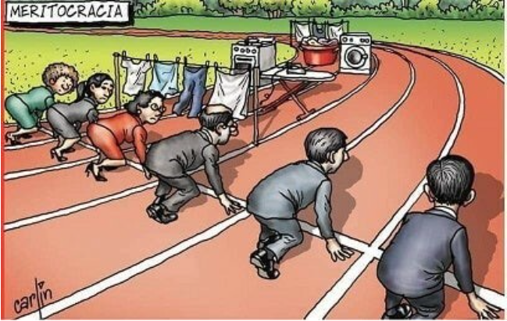
Cartoon by Carlin
Notes:
Ask the participants what do they think about this image, and it relates with what they noticed in doing the power power walk?
The women and the men are at the same starting point, however, the women have additional barriers in their lanes that will prevent them from winning or completing the race.
What causes gender inequalities?
1- Unequal gender roles (limit women’s employment participation and advancement)
Gender-roles: Social and behavioral norms that, within a specific culture, are widely considered to be socially appropriate for individuals of a specific sex. These often determine the traditional responsibilities and tasks assigned to men, women, boys and girls.
2- Unequal social/gender norms and stereotypes (perpetuate inequalities and value male authority and privilege):
Gender norms: Accepted attributes and characteristics of male and female gendered identity at a particular point in time for a specific society or community. They are the standards and expectations to which gender identity generally conforms, within a range that defines a particular society, culture and community at that point in time. Gender norms are ideas about how men and women should be and act. Internalized early in life, gender norms can establish a life cycle of gender socialization and stereotyping.
Unequal gender relations (gender power inequalities in work and family; GBVH): See next sldes

Slide 9
Unequal power relations and patriarchy
A system producing and reproducing gendered and intersectional inequalities
Promotes male privilege by being male-dominated, male-identified, and male-centered
Key aspects: the domination of women
Patriarchy varies across societies and cultures, and also historically
Notes:
Patriarchy can be conceptualized as a system producing and reproducing gendered and intersectional inequalities, and men's power and women's subordination and opression.
It is a system built on social, political, and economic structures and practices designed for, and through which men hold more power and authority which subsequently leads to male privilege. This male dominance perpetuates beliefs and practices (cultural norms, gender roles and gender stereaotypes) that -- whether consciously or unconsciously -- favor men over women, and these beliefs are not just held by men, but by the majority of the people in that society, whatever their gender.
“Men as a group” and “women as group” is used here to underline not all men and not all women.
Existing gender power imbalances as well as gender divisions of labour, power, and control.

Slide 10
Gender equality
Equal visibility, empowerment and participation to women, men and gender diverse people in all spheres of public life, the workplace and the family.
Gender equality implies that the interests, needs and priorities of women, men and gender diverse people are taken into consideration, recognizing the diversity of different groups of women and men.
Notes:
The concept that women and men, and gender diverse people have equal conditions, treatment and opportunities for realizing their full potential, human rights and dignity, and for contributing to (and benefitting from) economic, social, cultural and political development. Gender equality is, therefore, the equal valuing by society of the similarities and the differences of men and women, and the roles they play. It is based on women and men being full partners in the home, community and society.
Equality does not mean that women and men will become the same but that women’s and men’s rights, responsibilities and opportunities will not depend on whether they are born male or female. Gender equality implies that the interests, needs and priorities of both women and men and girls and boys are taken into consideration, recognizing the diversity of different groups and that all human beings are free to develop their personal abilities and make choices without the limitations set by stereotypes and prejudices about gender roles. Gender equality is a matter of human rights and is considered a precondition for, and indicator of, sustainable people-centred development.

Slide 11
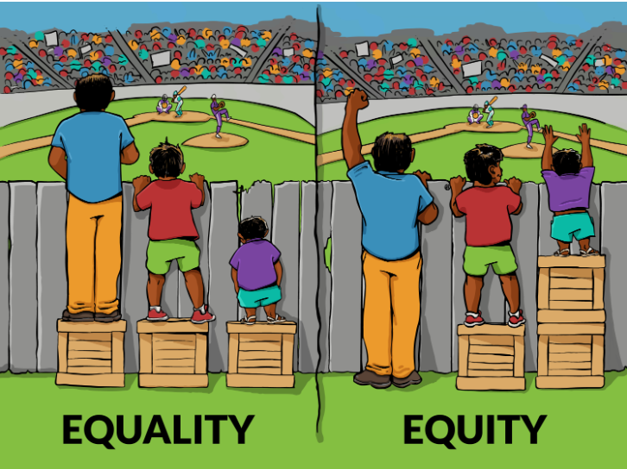
From Participatory Gender Audit Glossary, ITCILO
Notes:
The first image refers to equality of treatment is achieving equal treatment equal opportunity for everyone. This image assumes that everyone benefits from the same supports; all of the boxes are equal in size, however, they do not accommodate everyone equally. There is still one person who is unable to see the game with the box as a support. Formal equality: treating everyone the same (equality of opportunity)
In the second image: When we achieve equality in a genuine way, everyone gets the supports they need. Gender equity is the process to achieve gender equality; it recognizes that women are often not in the same starting position as men and that differential treatment may be required “to catch up”. This leads to Substantive equality: goes beyond equality of opportunity to take account of structural causes of gender inequalities (takes sex, race, ethnicity etc. into account)
Equality aims to promote fairness, but it can only work if everyone starts from the same place and receives the specific help they need to move forward. Equity may appear unfair as different measures are applied, but it actively moves everyone closer to success by levelling the playing field.

Slide 12
Ice breaker: a quick poll
Q1. Globally, women are paid around ?% less than men (mean hourly earnings)
5%
10%
20%
30%
Q2. At the current rate of progress in closing the gender pay gap, how many years does the ILO estimate that it will take to close the global gender pay gap?
1 year
15 years
57 years
113 years
257 years
Q3. International Equal Pay Day is celebrated on what day each year each year (to mark the moment when women effectively stop getting paid compared to their male colleagues)
18 June
18 September
18 November
Notes:
Tutor notes:
Q1. 20%
Q2. 257
Q3. 18 September.
As particpants to answer each question in turn, and then give the correct answer.
Then, give a short explanation of International Equal Pay Day and ask participants if they have participated in any activities on the day each year.
You can also introduce to participants to EPIC: https://www.equalpayinternationalcoalition.org
EPIC is the Equal Pay International Coalition. Led by the ILO, UN Women, and the OECD. The Coalition’s goal is to achieve equal pay for women and men everywhere.

Slide 13
Activity 1.3: Where do we stand on unequal pay between women and men?
Notes:
Tutor notes:
Three flip charts are placed around the room marked ‘yes’, ‘no’ and ‘not sure’.
Participants are asked to stand up.
The trainer reads a list of statements one-by-one (from a pre-prepared list). When each statement is read participants are asked to stand by the flip chart that best reflects their answer to the question.
After each statement ask participants to explain why they are standing beside their chosen flip chart.
Encourage discussion amongst participants on each statement. You can use all of the statements, select a few of them or introduce statements that are relevant to your sector or country context.

Slide 14
Module 2: What is pay equity and why it is a trade union issue
Notes:
Tutor notes:
For more detailed information, see Section 1 of the IndustriALL Pay Equity Toolkit

Slide 15
Why is pay equity an important priority for IndustriALL
IndustriALL is committed to ending inequalities between women and men through a transformational approach.
This means addressing the structural and root causes of inequalities.
Pay equity addresses the undervaluation of women’s work, which contributes to the gender wage gap.
Jobs commonly held by women tend to be paid less than jobs commonly held by men—even when the work is comparable in value based on skill, effort, responsibility, and working conditions.
The gender wage gap is a persistent problem.

Slide 16
Problems in achieving pay equity (1): Undervaluing of women’s work
Women’s skills are often regarded as ‘natural’ female characteristics rather than acquired skills e.g. undervaluing of care work
Gender bias in assessing women’s work
Difficulties related to measuring productivity in women’s work, e.g. care work
Gender stereotypes impacts on how we value women’s work and skills
Notes:
Tutor notes:
The next two slides highlight some of the problems encountered by unions in achieving pay equity. Use these slides to stimulate discussion about the problems faced by participants’ unions.

Slide 17
Problems in achieving pay equity (2): Lack of data on wages / transparent pay systems
Without data on wages , it is difficult to establish if there is gender bias in pay setting and job classification systems
Pay and grading systems sometimes separate out women’s work and men’s work into separate pay bands
Non-basic pay, performance and bonus payments more likely to benefit men’s jobs

Slide 18
Problems in achieving pay equity (3): Women are under-represented in positions of power
Women are under-represented in social dialogue / collective bargaining teams
Equal pay is generally low on the agendas in collective bargaining

Slide 19
However, the presence of trade unions has a positive effect overall
Overall, research from the OECD and ILO confirms that trade unions have a positive effect on reducing the gender pay gap.
According to H&M commissioned research on living wages in the garment sector:
  When suppliers participate in workplace social dialogue programmes and factory-level wage management, real wages increase by an average of 2.8%.
  When combined with a wage grid that classifies jobs by skill level, the wage effect is amplified by 5% (on average).
  The presence of trade unions at the factory level is estimated to add another average of 5.5% to wages.
Notes:
For further information about H&M’s research: https://flagship-report.theglobaldeal.com/case-study/promoting-living-wages-in-hm-group

Slide 20
Activity 2.1: Definitions of pay equity, gender pay gap and equal pay for work of equal value
Pay equity
Gender pay gap
Equal pay for work of equal value

Slide 21
Pay equity is about equal pay for work of equal value
Equal pay for work of equal value means that:
  two different jobs that contribute equal value to an employer’s operations means that workers in those jobs should receive equal pay
  It is like comparing apples to oranges – they are different, but equally nutritious – for example:
Comparing the value of a truck mechanic job (commonly held by men) to that of an account technician job (commonly held by women).
Pay equity is internationally recognized as a fundamental human right

Slide 22
Continued…
Pay equity is goal for all workers, regardless of their employment or contractual status and whether or not they work in the formal or informal economy.
Encompasses strategies to address the structural causes of pay inequalities such as occupational segregation, women’s burden of care responsibilities, power inequalities in the workplace and gendered stereotypes that result in the undervaluing of women’s work and skills.
Notes:
Tutor notes:

Slide 23
International standards
ILO Convention No. 100: implements the principle of equal pay for work of equal value.
  Has C100 been ratified and implemented in your country?
SDG Target 8.5: By 2030, achieve full and productive employment and decent work for all women and men, including for young people and persons with disabilities, and equal pay for work of equal value.

Slide 24
What are the causes of the gender pay gap?
We need to understand the causes of the gender pay gap if we are to build effective strategies to end inequalities between women’s and men’s pay.
In your experience, what are the main causes of the gender pay gap?
Let’s go on now to look at how the gender pay gap is explained.

Slide 25
Gender pay gap: explained and unexplained causes
‘Explained’ (individual and organisational characteristics):
Educational and training
Work experience in the labour market, seniority in the organization or in the job held
Working hours
Size of organization / sector of activity
Care / motherhood care gap: shorter working hours, part-time work, delayed careers owning to childcare responsibilities
In calculating the “adjusted” GPG factors such as education and training and working hours are taken into account.
‘Unexplained’ (structural causes, discrimination & undervaluing of women’s work):
Occupational segregation: when women are predominately in a sector their wages are lower than when men are predominant in a sector
Systemic and historical under-evaluation of women’s work
Gender stereotypes and prejudices
Traditional job evaluation methods designed on the basis of the requirements of male-dominated jobs
Weaker bargaining power of female workers (lower unionisation and disproportionately holding precarious jobs)

Slide 26
What are the factors impacting on the gender pay gap? (ILO Wage Report 2019)
Educational attainment
  in highly feminised sectors/occupations (even with the same or higher education attainment) women receive less pay.
Occupations and workplaces with higher the degree of feminisation pay less
  at enterprise level, the higher degree of feminisation in the workplace the lower the average pay received from that enterprise
  when women begin to exceed 65% of the waged workforce their pay declines relative to more mixed workforces in similar enterprises
  pay declines even further when women represent over 90% of the workforce in an enterprise.
Motherhood pay gap
  when hourly wages of mothers and non-mothers are compared – mothers experience a wage penalty as high as 30%.
Notes:
Does pay increase or decline when women enter an industry or particular field in greater numbers?
Women’s jobs tend to be lower valued, particularly when clustered in ‘typical’ female jobs or if they are part-time
How does gender bias / social norms about how we give value and worth to different economic roles impact on wage determination processes?

Slide 27
It’s also linked to wage setting systems…
Historical gender bias in pay setting and job classification systems
Pay and grading systems / bargaining groups may separate out women’s work and men’s work into separate pay bands / negotiations
Marketisation and individualisation of pay - non-basic pay, performance and bonus payments more likely to benefit men’s jobs
Gender stereotypes impact on how we recognise and value women’s work and skills
Women’s skills are often regarded as ‘natural’ female characteristics rather than acquired skills – viz the undervaluing of care work

Slide 28
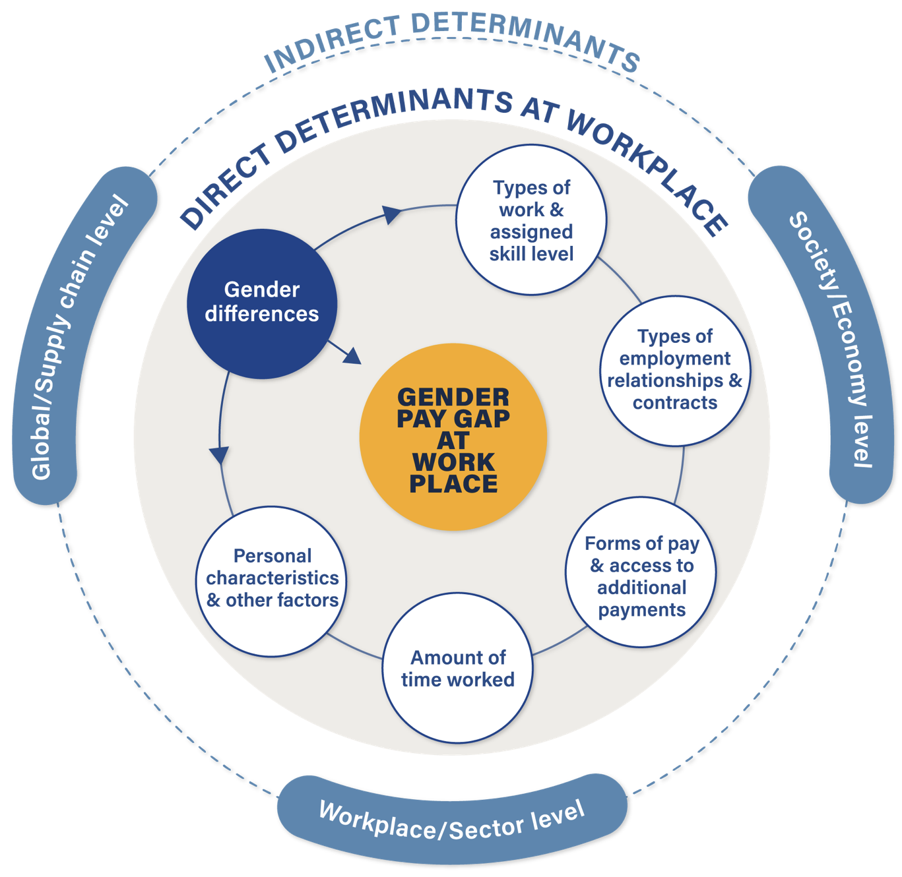
Notes:
This chart is from the Anker Foundation’s (2023) report on gender pay gaps in global supply chains. See Briefing 4 in the training pack for a summary of the research.

Slide 29
Discussion
What actions have already been taken by your union on pay equity? (including actions to close the gender pay gap and achieve equal pay for work of equal value)
What challenges do you face?
What specific strategies do you think can be implemented to overcome these challenges?

Slide 30
In summary…
Jobs requiring similar skills, qualifications or experience tend to be poorly paid and undervalued when they are dominated by women rather than by men.
When women enter an industry or particular field in greater numbers, pay declines for the very same jobs that more men were doing before.
Gendered valuations are deeply embedded in formal wage determination processes
Decisions about these roles contribute to the unconscious bias at work in how we perceive value and worth of a particular job.

Slide 31
Module 3: Pay transparency and gender pay gap reporting

Slide 32
What is gender pay gap reporting?
The GPG is the gap between women’s and men’s pay – the figure varies depending on which measurement is used:
  Mean GPG or median GPG?
  Hourly, monthly or yearly earnings?
  In practice, most gender pay gap reporting covers mean and median GPG based on hourly earnings.

Slide 33
Definitions: mean or median
Mean – the average wage among all wage employees / the average of all the values covered
  compares average of women’s pay to average of men’s pay in the wage distribution
Median – the middle wage earner / located in the middle of the wage distribution
  compares the value located in the middle of the female / and male wage distribution; half earn more than the median salary, half earn less
Mean and median can often produced different and contradictory results.
Global estimates range from 16% pay gap (mean hourly wages) to 22% (median monthly wages)
Notes:
But the distribution of pay among employees is usually very skewed. The highest-paid staffers earn significantly more than the lowest paid, so the mean, or average, tends to be much higher than the median.
Because there are generally fewer women in higher-paying roles than men, the gender pay gap as measured by mean earnings is often higher than for median earnings. As a result, many companies use the median in most instances because it is closest to the experience of the typical man and the typical woman. However, the mean often reflects the specific problem of a lack of women in high-paying roles.
In the UK, according to the ONS, the mean hourly gender pay gap for full-time workers was 14.1 per cent, compared with 9.1 per cent for the median.
Bangladesh is the only country in the world with a positive GPG (as against the world average of 21,2%, and a LMIC average of 21,4% – this is the case even when it is factor weighted (hourly earnings). Why?
Currently, Bangladesh is creating low end jobs on a large scale, where there is a little difference between men and women in terms of skill, and women get job opportunities and the wage difference is comparatively low – compared to higher paid jobs. Interestingly Bangladesh along with other LMICs saw wage growth – in Bangladesh it was 3% (last year 3.6%) - compared to high income countries where wage growth has stagnated.
This is not to say that all is equal in Bangladesh – and pay discrimination exists – it is in part a product of a low wage economy where there is clustering of low paid work shared by women and men in predominantly female sectors, particularly the garment sector. Employment growth in the RMG sector has increased women’s wages and reduced men’s.
“Stop the Robbery” campaign in Bangladesh, which calls for equal pay and women's economic empowerment as part of achieving full gender equality.

Slide 34
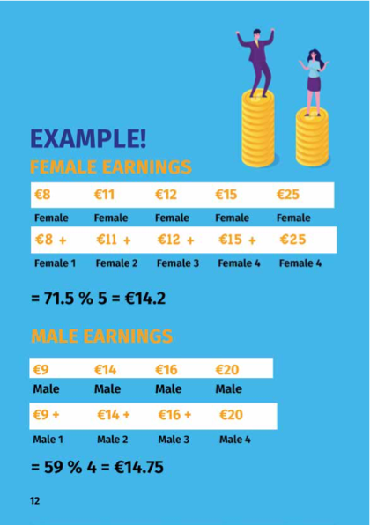
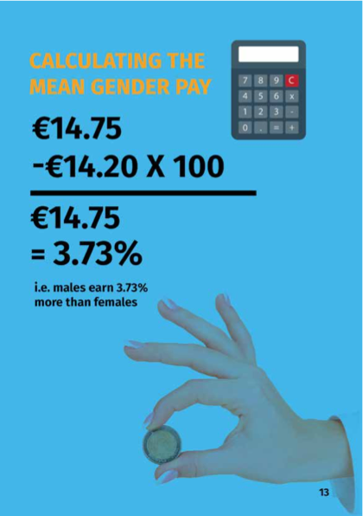
Source:
FSU “The Gender Pay Gap Won’t Close Itself”

Slide 35
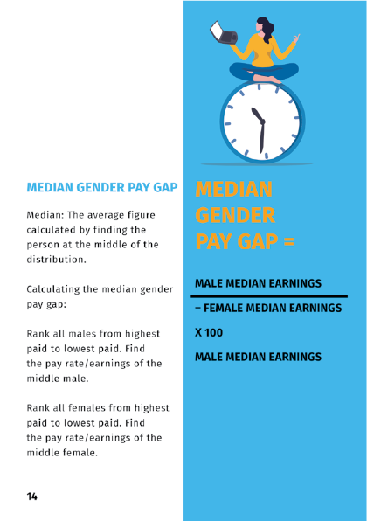
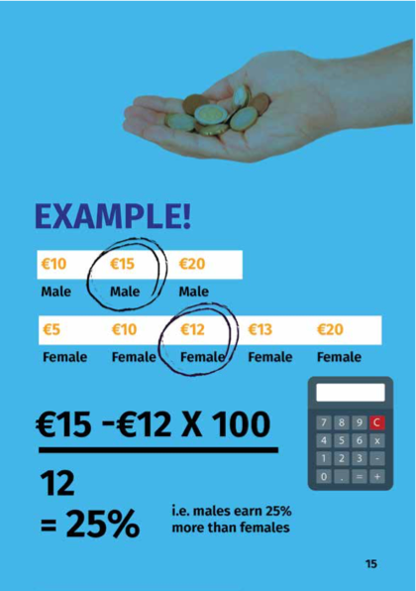
Source:
FSU “The Gender Pay Gap Won’t Close Itself”

Slide 36
Steps involved in identifying gender pay gap gap reporting in the workplace
Identify average hourly earnings of men and women (mean and median)
Identify average hourly bonus payments of women and men (mean and median)
Calculate the gender pay gap for hourly earnings and bonus payments
Identify the % earnings of women and men in four pay quartiles.
Produce a report with the evidence and an action plan to address the gender pay gap

Slide 37
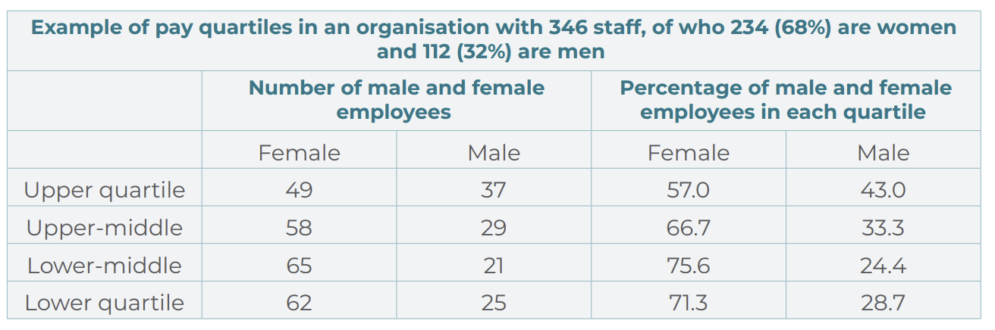
How to organise workers into pay quartiles?
Notes:
Workers are separated into four pay groups (upper, upper-middle, middle, lower) based on the hourly pay of male and female workers.
Each quartile should represent a quarter (25%) of the total workforce.
This will help unions to get a picture of where women predominate in the four quartiles. When examining pay quartiles, it is often the case that women predominate in the lower pay quartile, in which case it is important to put in place strategies to address occupational segregation.

Slide 38
What to report on?
Hourly earnings
  Difference between male and female mean hourly earnings (%)
  Difference between male and female median hourly earnings (%)
Bonuses
  Difference between male and female mean bonuses (%)
  Difference between male and female median bonuses (%)
Bonus pay
  % of male and female employees who receive bonus pay
  % of male and female employees who receive benefits in kind
Notes:
Tutors notes:
Consider also how to collect data on part-time workers hourly earnings and bonuses, and temporary/non-standard workers hourly earnings and bonuses.

Slide 39
What is pay for the purposes of gender pay gap reporting?
What is included in hourly earnings?
Allowances e.g. recruitment and retention allowances and car allowances
Pay for piecework
Leave pay e.g. annual leave, maternity leave
Shift premium pay
Performance related pay
What is not included?
Overtime pay
Redundancy or termination pay
Pay in lieu of leave
Benefits in kind
Childcare services and health plans
What makes up bonus pay?
Money, vouchers, securities, security options, interests in securities
Payment linked to profit sharing, productivity bonus, PRP, incentive or commission pay

Slide 40
What can unions do to promote gender pay gap reporting?
Ensure union representation and consultation
Request information from the employer
Argue for a comprehensive approach
Agree actions and a plan to tackle identified gender pay gaps
Negotiate strategies to make performance-related pay and individually negotiated pay transparent
Unions who are also employers should carry out their own internal gender pay gap reports
Unions can carry out a gender pay gap report in the workplace
Notes:
There are many ways that unions can take a role in negotiating with employers on ways to report on the gender pay gap. Unions have an important role to play in holding discussions with employers.
Ensure union representation at all stages in the process of gender pay gap reporting, including in drawing up an action plan to address identified pay gaps.
Request information from the employer on pay scales and bonuses, including how bonuses or performance related pay are calculated and awarded, and if there are differences between male and female workers.
Argue for a comprehensive approach, covering basic pay, bonuses, and gender pay gaps faced by part-time and non-permanent workers.
Agree actions to tackle identified gender pay gaps that address the structural and root causes of the gender pay gap.
Negotiate strategies to make performance-related pay and individually negotiated pay transparent, and negotiate to ensure that these systems to do not disadvantage women workers and lead to a wider gender pay gap.
Unions who are also employers should carry out their own internal gender pay gap reports. This can help to build union awareness in negotiating for a pay transparency and gender pay gap reporting.
If an employer does not agree to undertake gender pay gap reporting, unions can carry out a gender pay gap report in the workplace through an anonymous survey with workers to identify different pay levels and bonuses, or by drawing on gender breakdown of pay data provided by the employer, if available.

Slide 41
Activity 3.1: Identifying the gender pay gap
Notes:
Tutor notes:

Slide 42
Activity 3.2: Next steps in preparing for gender pay gap reporting
Notes:
Tutor notes:

Slide 43
Day 2

Slide 44
Module 4: Gender-neutral job evaluation

Slide 45
Group activity 4.1: What do you understand by gender-neutral job evaluation?
Notes:
Tutor notes:

Slide 46
Gender-neutral job evaluation
A process for determining the relative value of work and for establishing an appropriate job classification
A tool for establishing a transparent and equitable wage structure - based on equal pay for work of an equal value
Highlights pay inequalities in jobs that are equally valued
Across an organisation or workplace, a sector or in comparing one job to another job
Various methods for job evaluation, from simple to complex
Key to all methods is to ensure that job evaluation is free from gender bias

Slide 47
Why is it important?
Women’s jobs tend to be lower valued, particularly when clustered in ‘typical’ female jobs or if they are part-time
Undervaluing women’s work and talent is a lost resource for companies, the labour market and society
Making best use of women’s skills is good for motivation, productivity and competitiveness
Companies can recruit and retain the best employees if employees know that their work is rewarded fairly
Gives greater chance for women to be economically independent across the lifecourse
Increasing women’s earnings reduces the risk of poverty in retirement

Slide 48
Examples
Domestics (who are all women) wash floors, work a 39-hour week and earn 30% less than wall washers who are all men and who work a 37-hour week
A nurse with a degree level qualification, five years experience and supervises 15 staff earns 33% less than a craft supervisor who has three years job experience and supervises two people
Men carrying out manual work on the same grade as women receive a bonus, whereas women do not.

Slide 49
Benefits of gender-neutral job evaluation
An objective and analytical method – jobs are analysed for their content, not the individual characteristics of a worker
The relative value of new jobs created can be established
Helps in drawing up job descriptions, job specifications, competencies and performance appraisal systems
Jobs can be analysed that have changed over time
Takes account of the need for increasing levels of specialisms and complexity in organisations
Basis for good trade union/employee – employer relationships in the workplace

Slide 50
Benefits (2)
Transparency in determining pay and the pay structure
Upgrades the value of women’s work and reduces incidence of low paid work
Creates a positive work environment and confidence of employees
Reduces individual or union grievances about unfair pay
Enables employees to identify skills and competency gaps
Remedies can be developed to address skills gaps, career development, under-representation of women in senior positions etc.

Slide 51
Carrying out job evaluation
Pay is determined by scoring points for factors or sub-factors or ranking jobs
Job analysis enables the relative value of jobs to be established in an objective and analytical way
Can be complex in large and diverse organisations
Important to have a clear job description/job content setting out the tasks, duties and responsibilities for each job being evaluated

Slide 52
Steps involved in job evaluation
Step 1: Identify jobs for comparison
  Examine pay data and differences in pay between jobs predominantly carrid out by men and women
Step 2: Job descriptions
  Collate job descriptions / write job descriptions
  Check job content with job holder and line manager
Step 3: Select factors and sub-factors for comparison (skills, effort, responsibility, working conditions)
Step 4: Make equal value assessment
  Compare factor by factor
  Make overall assessment

Slide 53
Pay equity example from Canada
This video from Canada gives the example of the warehouse person (predominantly masculine) and administrative assistant (predominantly women). It shows how gender neutral job evaluation can show the undervaluing of women’s jobs and a basis for equal pay for work of equal value.
https://www.equalpayinternationalcoalition.org/en/equal-pay
Notes:
Tutor notes:
Canada is one of the leading countries on implementing pay equity. Employers are required to carry out gender-neutral job evaluation under the Canadian Human Rights Act, and in federal and provinicial pay equity laws. Pay equity legislation is proactive and designed to uncover systemic undervaluing of work predominantly carried out by women. A worker or employer can also carry out a comparison with a ‘proxy’ and comparisons can be made between job classes.

Slide 54
Activity 4.2: Understanding gender bias in how we evaluate jobs
Notes:
Tutor notes:

Slide 55
Do we undervalue or overlook skills held by women?
Q. Are there aspects of the work generally performed by women that are overlooked or undervalued?
Q. Can you give some examples of aspects of the jobs held by women that are undervalued or overlooked?
Identify if they are related to:
Skill
Effort
Responsibility
Working conditions
Notes:
Tutor notes:
This slide poses two questions for discussion in the full group. It is important to get participants to reflect on these issues and, if necessary, change their perceptions about how we value the work carried out by women and men.
The next four slides go into each of these four areas in more detail, highlighting aspects of jobs carried out by women that may be overlooked or undervalued.

Slide 56
1. Skill
Knowledge, skill and experience that are needed to perform the work
Mental, social and physical skills and abilities; problem-solving skills, independent judgement and decision-making
Job demands that may be overlooked or undervalued:
Manual dexterity
Multi-tasking skills / operating and maintaining multiple forms of equipment
Inter-personal skills
Keyboard skills
Clerical skills and knowledge (various computer software, data entry, calendar and email management, etc.)
Correspondence writing and editing
Office management and operation
Client service skills (empathy, communication, etc.)
Counselling and interviewing
Notes:
Tutor notes:
For each of the four slides that follow (skill, effort, responsibility, working conditions) start by identifying the description for each job demand and then go on to discuss the job demands that may be overlooked or undervalued.
These overlooked or undervalued aspects are important to make visible and to ensure equal pay for work of equal value.

Slide 57
2. Effort
Physical, intellectual or mental demands of the job, e.g. maintaining uncomfortable positions, using physical strength or concentration for long periods.
Frequency, duration, exertion, strain, stress.
Job demands that may be overlooked or undervalued:
Physical effort from regular, restricted or light repetitive movements
Dealing with dissatisfied or aggressive customers
Lifting older people who are frail or vulnerable
Intense concentration over long periods of time
Notes:
It has been noted that most job evaluation methods used in traditional work contexts have put almost exclusive emphasis on physical effort. Traditional methods have focused on physical effort, in particular that which is associated with blue-collar jobs in the manufacturing or construction sectors. However, when addressing pay equity, it is important to redefine physical effort and take mental and emotional effort into account as well.

Slide 58
3. Responsibility
Being held accountable for performing an aspect of the job.
Responsibility for resources, such as human, financial and technical resources, health and safety etc.
Supervisory roles – responsibility for people, equipment or clients
Job demands that may be overlooked or undervalued:
Confidentiality and handling sensitive information
Managing and organising meetings
Caring for people, emotional support, reassurance and comfort
Knowing emergency procedures
Training and orientating new staff
Material resources (supplies, office equipment etc.)
Coordination of work and schedules
Bookkeeping

Slide 59
4. Working conditions
Conditions and environmental factors associated with performing the work
In the physical environment e.g. temperature and noise
In the psychological environment, e.g. emotional and mental stress.
Job demands that may be overlooked or undervalued:
Frequent interruptions
Urgent and unexpected requests
Variable work schedule
High noise levels
Information gathering
Emotionally stressful situations e.g. dealing with challenging clients
Exposure to chemicals and corrosive substances

Slide 60
Summary
The undervaluing of the skills and work carried out by women is one of the major causes of the gender pay gap.
Women’s skills and knowledge are frequently overlooked in the setting of wages.
Gender-neutral job evaluation is a tool to compare different but equally valued jobs, (across demands of the job based on qualifications/skills, effort, responsibilities and working conditions).
Unions should ensure that all job classifications are gender-neutral. This means rectifying any historical bias and stereotypes that put a higher value on men’s jobs, compared to women’s jobs.

Slide 61
Activity 4.3: Comparing the value of two jobs (administrative assistant and maintenance assistant)
Notes:
Tutor notes:

Slide 62
In summary, trade unions have a role to:
1. Include gender-neutral job evaluation in negotiations, ensuring gender-neutral and non-discriminatory criteria are used to evaluate jobs using analytical factors (skill, effort, responsibility, and working conditions).
2. If a job evaluation scheme has previously been undertaken, ask management to review it to identify any potential gender bias that may have led to inappropriate job classification and undervaluation.
3. Provide training and guidance for union representatives to recognise unequally valued jobs and to understand how gender-neutral job evaluation can be conducted in practice.
4. Ensure union involvement in designing and implementing job evaluation schemes.
5. Check that the job evaluation scheme is analytical and addresses gender bias.
6. Select jobs that are equally valued for comparison. Usually, this means finding higher-paid comparators within the company or, if this is not possible, in another company or sector that perform different work.
7. Where possible, compare jobs with those in male-dominated, higher-paying occupations and sectors. If no male comparator is available, try arguing for the use of hypothetical comparators.

Slide 63
Detailed overview of steps in carrying out job evaluation
Additional slides for participants involved in collective bargaining
Notes:
Tutor notes
Slides 63 – 77 provide more detailed information on the steps involved in job evaluation. This will be useful for union representatives involved in collective bargaining.
Tutors must be familiar with the ILO’s Guide to Gender-Neutral Job Evaluation for Equal pay (which provides more detailed information):
https://www.ilo.org/sites/default/files/wcmsp5/groups/public/@ed_norm/@declaration/documents/publication/wcms_122372.pdf

Slide 64
Step 1: Identify jobs for comparison
Slide for a deeper understanding: for members of collective bargaining teams
1) Draw up a list of the jobs in the enterprise or identified department of the enterprise
2) Determine whether these jobs are male- or female-dominated
3) Ensure that the criteria used to determine predominance are rigorous
4) Ensure that there is no gender bias
5) In the absence of male comparators, consider hypothetical jobs
The purpose is to evaluate and compare jobs in order to identify discrimination in pay and to determine unequal pay between predominantly female and predominantly male jobs. The jobs may be similar or different, but they may be of equal value.
Remember that the comparisons aim to show that two jobs are of equal value and, therefore, should receive equal pay.
When selecting jobs to compare, make sure that they are jobs that may be equally valued, e.g. a nurse v electrician, a cleaner v maintenance worker.
Notes:
In some countries, a job is considered to be female or male-dominated if women or men represent at least 60 per cent of those performing the job (as is the case in Canada). In other countries, the threshold is set at 70 per cent. There are no conclusive studies indicating what the optimal threshold should be.
Examples of hypothetical comparators could include: a nurse working in care of the elderly compares her pay with the pay of a plumber working whose earnings are higher than the nurse; or a woman working in administration who carries out multiple tasks for management compares her job with a car mechanic earning higher pay. A hypothetical comparator can help to demonstrate that if a man was employed on a job of an equal value in the same workplace, the jobs carried out by women would still be lower paid . This will be relevant where women’s jobs are clustered into highly-feminised occupations.

Slide 65
Step 2: Job descriptions
Slide for a deeper understanding: for members of collective bargaining teams
Collect job descriptions of all jobs to be evaluated.
Consult with workers (holding the jobs to be evaluated) and their supervisors e.g. through group meetings and one-to-one interviews, and ensure that the job descriptions are:
  up to date
  fully reflect the skills, training, effort etc. for the job
  that there is no gender bias in the way that the job is described
If job descriptions need updating, unions can support workers e.g. by keeping a diary for one or two weeks to set out their work tasks.
Notes:
The job holder, the person who does the job in question, is a privileged source of information. Ensure that both sexes are represented. Of course, a discussion with the immediate superior is also important. He or she can provide further relevant information for the job description. A job interview and in some situations a visit to the workplace provides a great deal of information and is an ideal way to test the job information and pre-conditions. A preparatory and clear questionnaire breaks down barriers and will provide objective information.

Slide 66
Step 3: Select factors and sub-factors for comparison
Slide for a deeper understanding: for members of collective bargaining teams
The four basic factors should be broken down into sub-factors
Between 10 and 16 sub-factors in total
Take into account the more detailed and varied characteristics of the different types of jobs in each enterprise
Examples of subfactors under Qualifications, skills and knowledge
work-related knowledge
manual dexterity
interpersonal skills
Notes:
This will make it possible to take into account the more detailed and varied characteristics of the different types of jobs in each enterprise.
Most methods include between 10 and 16 sub-factors in total, depending on the size of the enterprise and the variety of jobs to be evaluated.
For example, the qualifications factor can be broken down into work-related knowledge, manual dexterity and interpersonal skills, while the effort factor can be broken down into mental effort and physical effort, and so forth.
While the sub-factors chosen must come under one of the four basic factors, the choice and the way they are interpreted in concrete terms can vary depending on the economic sector

Slide 67
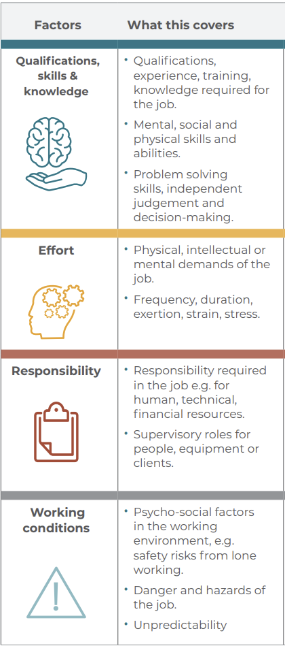
Factors involved in job evaluation
Qualifications, skills and knowledge
Effort
Responsibility
Working conditions
Notes:
According to evaluation and compensation experts, these four factors are essential and sufficient for evaluating all the tasks performed in an organization, regardless of which economic sector the enterprise belongs to.
Under each factor, it is possible to list sub-factors specific to the jobs being evaluated.

Slide 68
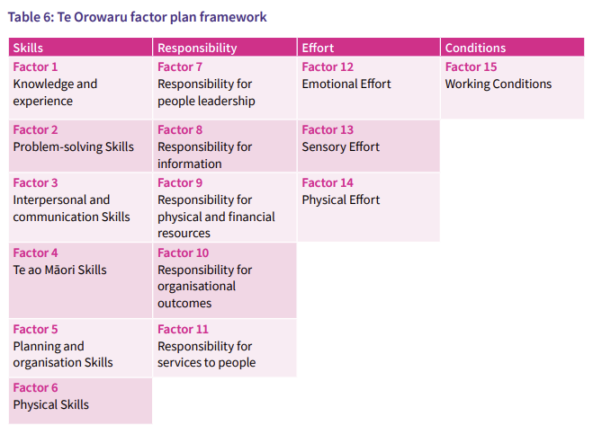
Slide for a deeper understanding: for members of collective bargaining teams
PAY EQUITY TOOLS AND RESOURCES: EXAMPLE FROM NEW ZEALAND
Pay Equity Assessment Process Guide- https://www.publicservice.govt.nz/assets/Pay-Equity-Process-Guide-1-v2.pdf

Slide 69
Group activity 4.4: Identifying factors and sub-factors of a job
Notes:
Tutor notes:

Slide 70
Qualifications, skills and knowledge
Effort
Responsibility
Working conditions
In the garment & textiles sector, workers carry out machine work to produce garments on time on a production line. She is required to have manual dexterity to complete detailed machine work. She may have to work long hours in difficult conditions, sitting over a machine for long hours, resulting in musculoskeletal problems. Further health risks arise from constant close visual attention, exposure to dust and chemicals emitted from fabrics and strain from repetitive movements. Many garment workers lose their jobs by the age of 35 years because of the long-term impact of these physical problems. Most garment workers earn very low wages and have to resort to working long hours and overtime to meet their daily living needs.
Under each factors, identify sub-factors factors against which you could evaluate the job of worker producing garment

Slide 71
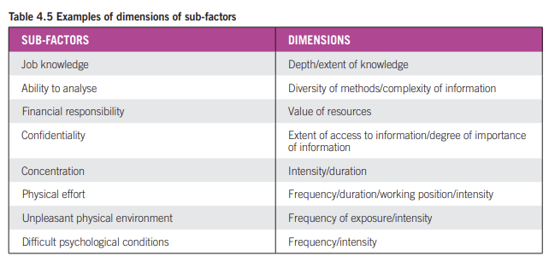
Example: Levels of sub-factors and development of scale
Slide for a deeper understanding: for members of collective bargaining teams
PROMOTING EQUITY: GENDER-NEUTRAL JOB EVALUATION FOR EQUAL PAY: A STEP-BY-STEP GUIDE
https://www.ilo.org/sites/default/files/wcmsp5/groups/public/%40ed_norm/%40declaration/documents/publication/wcms_122372.pdf
Notes:
In order to be able to differentiate between various jobs, each sub-factor in the method chosen must be divided up into levels or degrees. For example, some jobs may involve a high level of financial responsibility while others may involve almost none at all. Similarly, some jobs may involve a high degree of manual dexterity while others require very little. These differences in significance or intensity require the development of scales by which they can be measured.
The dimension measured will vary depending on the type of sub-factor

Slide 72
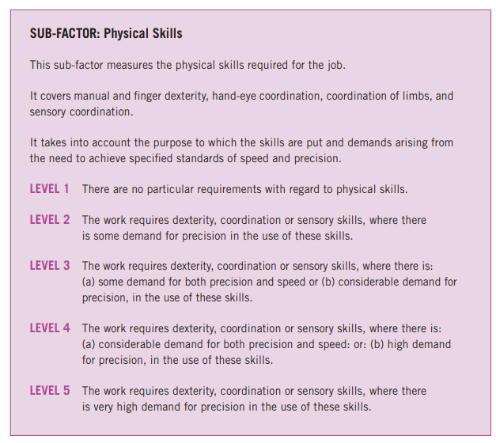
Example of levels
Slide for a deeper understanding: for members of collective bargaining teams
PROMOTING EQUITY: GENDER-NEUTRAL JOB EVALUATION FOR EQUAL PAY: A STEP-BY-STEP GUIDE
https://www.ilo.org/sites/default/files/wcmsp5/groups/public/%40ed_norm/%40declaration/documents/publication/wcms_122372.pdf

Slide 73
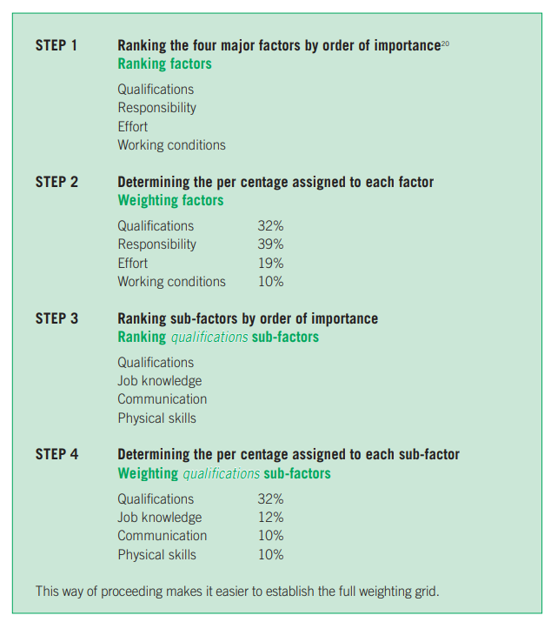
Example: Factor weighting
Slide for a deeper understanding: for members of collective bargaining teams
PROMOTING EQUITY: GENDER-NEUTRAL JOB EVALUATION FOR EQUAL PAY: A STEP-BY-STEP GUIDE
https://www.ilo.org/sites/default/files/wcmsp5/groups/public/%40ed_norm/%40declaration/documents/publication/wcms_122372.pdf
Notes:
The weighting of evaluation factors involves determining their relative importance and assigning a numerical value to each of them. Gender bias may affect the decision on how to weight factors. Developing the weighting grid A weighting grid indicates the relative importance of each factor and sub-factor for the organization. It is essential to use the same weighting grid for all the jobs covered by the pay equity programme.
Gender bias risk:
A JE should not give very high or very low weights to factors that are exclusively found in jobs performed mainly by either men or women.
Important to avoid assign a high weight to some factors, simply because they are representative of high-level jobs in the hierarchy; in such a case, the discrimination causing unequal pay may be reproduced. Thus, the hierarchical structure of the enterprise should not influence the weighting of factors.

Slide 74
Avoid gender bias by choosing and defining the factors and sub-factors in non-discriminatory ways
Ensure that all relevant sub-factors are included in jobs mainly done by women
Avoid double-counting a job demand
Be precise in defining the sub-factor
Slide for a deeper understanding: for members of collective bargaining teams
Notes:
Skills undervalued because they are thought to be the skills or attributes that women either naturally possess or acquire through life experience, and so may be omitted from a job evaluation.
If factors are not chosen carefully, they may duplicate or overlap. This can lead to one or more demands of a job being counted more than once, exaggerating the overall demands of the job, as in the following example.
The lack of a precise definition would likely lead to unreliable results. So factors need to be clearly described so that they are readily understood, and can be applied consistently and reliably. This reduces the risk of the subjective views of the job evaluators resulting in gender-biased results. Factor descriptions need to describe the meaning and scope of each factor. The description must be impartial, and should not imply assumptions about the gender of jobholders or the demands of work associated with one gender, because this may lead to undervaluing some job demands.

Slide 75
Step 4: Make equal value assessment/analysis
Slide for a deeper understanding: for members of collective bargaining teams
The most common is to draw up a questionnaire. Trade unions can help to ensure that company job evaluation questions are:
Gender-neutral
Questions related to job requirements rather than the attributes of the job holder.
Include commonly overlooked elements of female-dominated jobs.
Use active verbs to describe tasks (e.g. implement, motivate, record) rather than language that may devalue the job (only, basic etc.)
Clear questions are formulated to enable accurate information to be obtained. Thus, unclear questions should be avoided. For example, a question such as: “Are your tasks physically demanding?” should be replaced with “In performing your duties, do you have to move pieces of equipment, boxes or files? Indicate the weight (scale) and indicate the frequency (scale)”.
In addition, observation can complement the information obtained through the questionnaire. This may be necessary if where a job requirement is difficult to explain.

Slide 76
Possible gender biases in the analysis and evaluation of the jobs
Slide for a deeper understanding: for members of collective bargaining teams
The influence of the hierarchical rank
The influence of salary
The availability effect
The halo effect
Notes:
The influence of the hierarchical rank can also be a source of gender bias insofar as women’s jobs are mainly found in intermediate or lower ranks. Evaluators may correlate higher hierarchical rank with high levels for several factors, which is not necessarily accurate. The reverse can also happen for junior-level jobs.
The influence of salary can be seen to have a similar effect, that is, a highly-paid professional job may be assumed to involve demanding requirements pertaining to various sub-factors, which might not actually be the case
The availability effect relates to the most visible aspects of an occupation: for example, the most visible and well-known part of secretaries’ jobs, that is, word processing, can conceal other task requirements, such as filing or writing and revising texts. The less familiar factors may retain less attention on the part of evaluators and thus be assigned lower levels.
The halo effect can be seen when a job obtains a high level for a sub-factor which is considered to be prestigious, such as the diploma required, and from which it is inferred that the job must also receive a high score for other factors. On the contrary, the reverse halo effect can also be seen and can cause a drop in the levels assigned to jobs whose requirements, in terms of a diploma, for example, are low.

Slide 77
How to avoid gender biases in the analysis?
Job titles should not be associated with one or the other gender
Job salary not be indicated on the record for the job
Evaluation on a factor-by-factor basis guarantees that a standardized process will be applied to all jobs.
Scoring should be assigned for one sub-factor at a time for all jobs, that is, the evaluation should proceed on a sub-factor-by-sub-factor rather than a job-by-job basis
If each job is evaluated separately, the comparative approach, which is the very basis of the process, will be compromised
Evaluating in a random and variable order
Ensuring that levels are distributed equally among female- and male-dominated jobs
The comparative degree of detail and precision of female-dominated jobs and male-dominated jobs should be the same
Slide for a deeper understanding: for members of collective bargaining teams
Notes:
For each of the sub-factors, the order in which the jobs are evaluated should not be based on occupational group or job class so as to avoid the influence of gender-based prejudices. The order should instead be established randomly, as illustrated in the following example
In order to determine whether or not gender bias exists, the average of the scores assigned for each sub-factor can be calculated for male-dominated jobs and female-dominated jobs respectively. If, for example, it is found that female-dominated jobs tend to have been assigned average or low scores for most of the sub-factors while the opposite is true for male-dominated jobs, this means that the procedure may have been discriminatory.

Slide 78
Day 3

Slide 79
Module 5: Campaigning for living wages and the ending of low pay

Slide 80
Living wages
Campaigns for living wages are important in “raising the floor” and increasing wages for low-wage earners.
However, they do not address the causes of the low wages, such as occupational segregation and the undervaluing of women’s work.
Pay equity strategies should ensure, that as a starting point, all women workers have access to minimum wage protection, and where possible to advocate for this to be at levels that provide for living wages.
Research by the Anker Foundation shows that there is a gender gap in living wages: women are less likely to have living wages, compared to men.
Living minimum wages are essential for workers in the informal economy.

Slide 81
Examples of action taken by unions and informal workers’ organisations
An increasing number of unions are forging cooperation and signing MOUs with informal workers organisations.
In Zimbabwe is an MOU between the informal workers organisation ZCIEA and the national trade union ZCTU signed on 13 August 2004.
In India, the trade union SEWA (self-Employed Women’s Association) has advocated for a range of strategies by building the collective strength of informal workers through cooperatives and associations, enhancing skills, opportunities, sustainable livelihoods, income security and social protection.
HomeNet Thailand successfully campaigned for legal protection for homeworkers, which provides for fair wages and equal pay for workers doing the same work, workers have to be issued with contracts of employment and provided with occupational safety and health protection.
IndustriALL affiliate: the Amalgamated Union of Kenya Metal Workers (AUKMW) has organised informal workers and addressing the vulnerabilities faced by women in the mechanical sector, where women work as own-account workers frequently on piece rates without a formal contract.
Do you have any other examples? Does your union recognise and represent workers in the informal economy? Are informal workers organisations able to affiliate to your union?

Slide 82
Activity 5.1: Campaigning and bargaining for living wages and ending women’s low pay
Notes:
Tutor notes:

Slide 83
Module 6: Tools for workplace negotiations and collective bargaining

Slide 84
Union strategies to tackle pay inequalities between women and men
1. Raising the floor through living wages
2. Bargaining to end low pay in female dominated sectors
4. Gender-neutral job evaluation, with union involvement
5. Pay transparency and strategies to close the gender pay gap

Slide 85
Good practices in bargaining that impact on pay equity
Other issues that have been found to have a positive impact on pay equity:
Work-life balance / Reconciliation of work and family life
Company-level equal pay surveys / pay audits
Pay rises for low-paid workers / negotiation of sector-specific minimum wages
Additional pay increases for low-paid workers in female-dominated sectors – aim to level out wages across the economy resulting from occupational segregation
Job classification systems free from gender bias

Slide 86
Challenge 1: Many women work in part-time work, low paid sectors and weakly unionised sectors.
Women are under-represented in social dialogue / collective bargaining teams
Equal pay is generally low on the agendas in collective bargaining
Women’s labour market characteristics (skills, experience, education and training) do not explain why there is a gender pay gap

Slide 87
Challenge 2: Multiple factors cause the gender pay gap / pay inequalities
Social and cultural norms, traditions and stereotypes
Horizontal and vertical segregation in the labour market
Undervaluing of women’s work
Women often locked into precarious and low skill/low paid/low value jobs
Lack of transparency/discrimination in job classification systems / pay structures
Women are primary carers – reconciliation of work and family life
Poor career progression into senior and higher paid jobs

Slide 88
Activity 6.1: Advocating for pay equity in your union
Notes:
Tutor notes:

Slide 89
Activity 6.2: Preparing for collective bargaining
Notes:
Tutor notes:

Slide 90
Activity 6.3: Role play – negotiating for pay equity
Notes:
Tutor notes:

Slide 91
Module 7: Next steps and evaluation

Slide 92
Activity 7.1: Planning your next steps
Notes:
Tutor notes:

Slide 93
Identify one thing you will do immediately after the training
Consider how you can commit to implementing pay equity, such as:
-Find out if unequal pay / gender pay gap has already been identified as a problem in the workplace
- Plan a programme of training to raise awareness about pay equity
- Establish a committee with a view to drawing up a plan to implement pay equity
- Other
Activity 7.2:
Next steps after
the training

Slide 94
Evaluation
Notes:
Tutor notes:
See template for an evaluation questionnaire in the Pay Equity Training Pack.

Slide 95
Thank you!

